Slide 1
SEM2 CSC 1706 PROBABILITY AND STATISTIC
Section 01
Group Member’s Name
Md.Sariful Islam Abu Sayed Mohammed Saad Nasik Sami Mehran Mujib
MD.Afique Amin Zian

Slide 2
Introduction
The target for our survey audience are undergraduate students of International Islamic University Malaysia (IIUM).
In this survey, we have given three main choices for hours of part time job:
1)Less than 1 (one) hour
2)Between 1 (one) to 4 (four) hours
3)More than 4 (four) hours
The CGPA’s are classified into categories of:
1)2.1 – 2.5
2)2.6 – 3.0
3)3.1 – 3.5
4)3.6 – 4.0
We used a bar-chart for each category which is Less than 1 hour (X1), Between 1 to 4 hours (X2), and More than 4 hours (X3). We are assuming students who are working more than 4 hours has lower CGPA compared to a student who is working less than 1 hour.

Slide 3
Problem Statement:
When we were asked to choose a topic for our probability assignment, we thought amongst ourselves; “What is the most controversial topic in Malaysia?” We decided to address the most hotly debated topic of all time: Impact of part time job on the CGPA.
So our problem statement is -" Does part time job affect CGPA?"

Slide 4
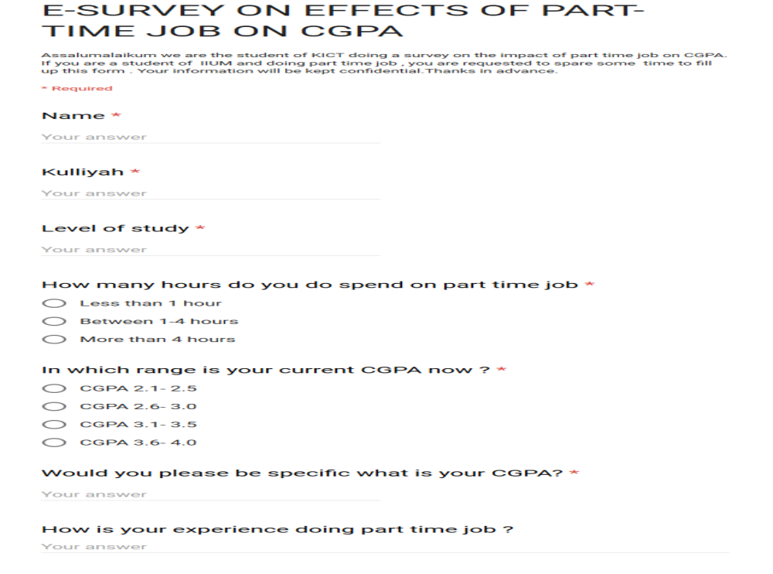
Questionnaire:

Slide 5
H-Test (Formula for the Kruskal-Wallis Test)
        Hours of part time job:
        X1 = Less than 1 hour
        X2 = between 1 and 4 hours
        X3 = more than 4 hours

Slide 6
DATA COLLECTION
CGPA | Hours Of Work | Rank
2.10 | X1 | 1
2.24 | X1 | 2
2.29 | X3 | 3
2.32 | X1 | 4
2.40 | X3 | 5
2.46 | X3 | 6
2.61 | X2 | 7.5
2.61 | X1 | 7.5
2.78 | X2 | 9

Slide 7
DATA COLLECTION
CGPA | Hours Of Work | Rank
2.85 | X3 | 10
2.97 | X3 | 11
3.11 | X3 | 13
3.11 | X2 | 13
3.11 | X2 | 13
3.30 | X3 | 15
3.32 | X2 | 16.5
3.32 | X1 | 16.5
3.35 | X3 | 18.5

Slide 8
DATA COLLECTION
3.35 | X1 | 18.5
3.37 | X2 | 20
3.39 | X2 | 21
3.40 | X1 | 23.5
3.40 | X2 | 23.5
3.40 | X2 | 23.5
3.40 | X1 | 23.5
3.42 | X2 | 26
3.43 | X3 | 27
3.45 | X2 | 28.5

Slide 9
DATA COLLECTION
CGPA | Hours Of Work | Rank
3.45 | X2 | 28.5
3.47 | X2 | 30
3.49 | X2 | 31
3.50 | X3 | 33
3.50 | X1 | 33
3.50 | X1 | 33
3.53 | X1 | 35
3.55 | X2 | 36
3.57 | X1 | 37.5

Slide 10
DATA COLLECTION
3.57 | X3 | 37.5
3.58 | X2 | 39.5
3.58 | X1 | 39.5
3.61 | X2 | 41
3.62 | X3 | 42
3.65 | X2 | 43.5
3.65 | X1 | 43.5
3.66 | X2 | 45
3.69 | X1 | 46

Slide 11
DATA COLLECTION
3.70 | X1 | 47.5
3.70 | X2 | 47.5
3.74 | X2 | 49
3.79 | X1 | 51.5
3.79 | X2 | 51.5
3.79 | X2 | 51.5
3.79 | X1 | 51.5
3.85 | X1 | 54
3.87 | X2 | 55

Slide 12
DATA COLLECTION
3.89 | X1 | 56
3.93 | X1 | 57
3.97 | X2 | 58
3.99 | X2 | 59
4.00 | X1 | 60

Slide 13
Hypothesis
        H0 = More hours of part time job have no effect on CGPA.
        H1 = More hours of part time job have effect on CGPA. (Claim)
        Critical Value:
        Using Chi-Square Table G; d.f = 3-1=2; α=0.05;
        C.V is 5.991.
        Test Value:
        R1=1+2+4+7.5+16.5+18.5+23.5+23.5+33+33+35+37.5+39.5+43.5+46+47.5+51.5+51.5+54+56+57+60 = 741.5;
        R2=7.5+9+13+13+16.5+20+21+23.5+23.5+26+28.5+28.5+30+31+36+39.5+41+43.5+45+47.5+49+51.5+51.5+55+58+59 = 867.5
        R3=3+5+6+10+11+13+15+18.5+27+33+37.5+42 = 221
        H = [12/{60*(60+1)}] * [{(741.5*741.5)/22}+{(867.5*867.5)/26}+{(221*221)/12}] –{3*(60+1)}
        = 7.186
        7.186> 5.991
        So, test value is greater than critical value. Decision is to reject null hypothesis. There is enough evidence to support the claim that more hours of job has effect on CGPA.

Slide 14
Method – Preliminary Analysis
CGPA Class | Hours In part time job | Class Boundary | Frequency | Cumulative Frequency
2.1-2.5 | x1 x2 x3 | 2.05-2.55 | 3 0 3 | 6
2.6-3.0 | x1 x2 x3 | 2.55-3.05 | 1 2 2 | 11
3.1-3.5 | x1 x2 x3 | 3.05-3.55 | 7 13 5 | 36
3.6-4.0 | x1 x2 x3 | 3.55-4.05 | 11 11 2 | 60

Slide 15
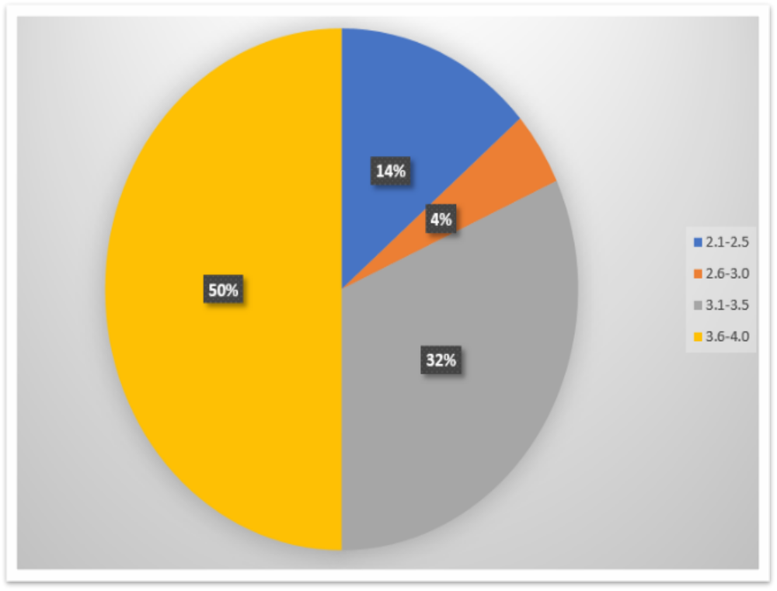
Pie chart off frequency of student’s CGPA
Less than one hour

Slide 16
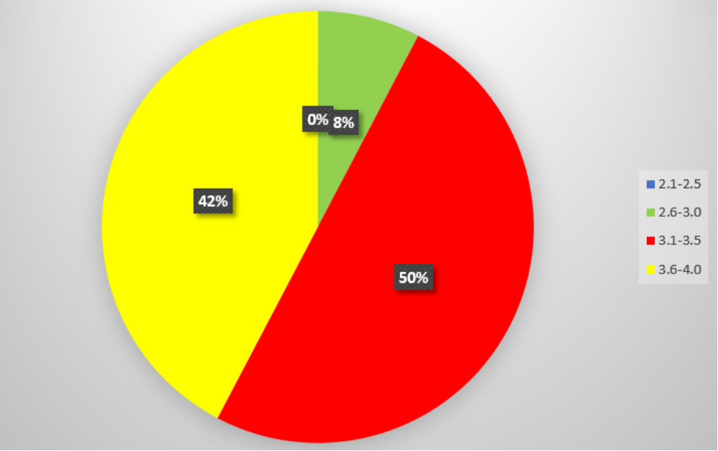
One to Four Hours of work

Slide 17
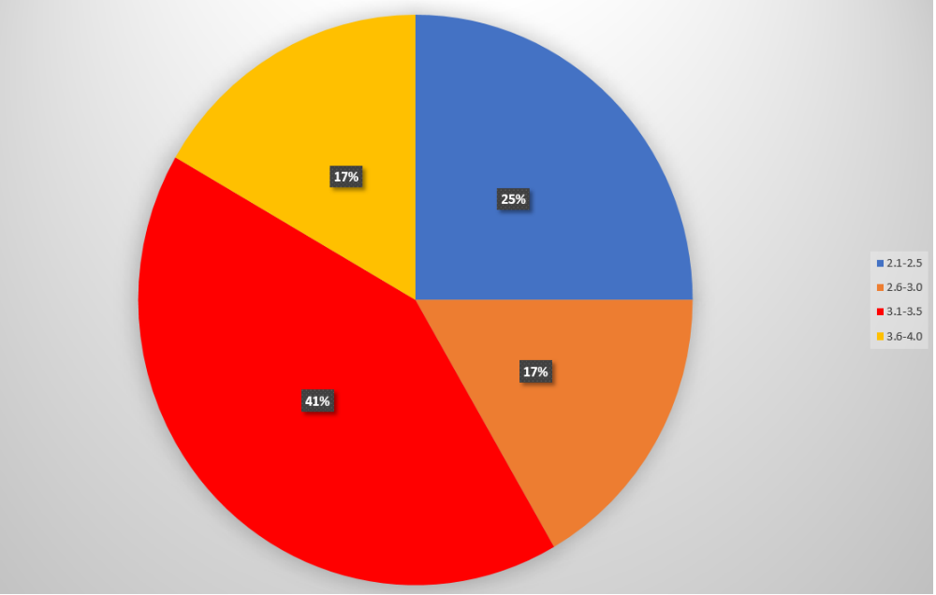
More than four hours

Slide 18
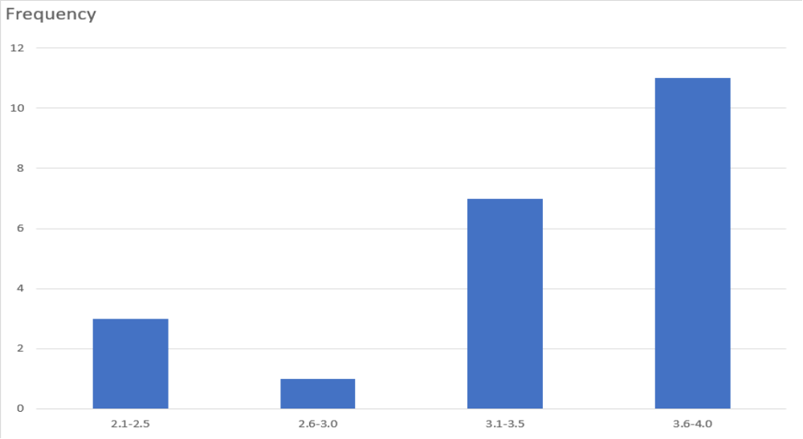
Analysis on category: Who spend less than one hour

Slide 19
Chebyshev’s Theorem
Mean = {(3*2.3) + (1*2.8)+(7*3.3)+(11*3.8)}/22
= 3.39
Modal Class = 3.6 - 4.0
Mode = 3.8
Midrange = 3.05
Variance = {(22*258.78) - (74.6^2)}/ (22*21)
= 0.277
Standard Deviation = root over 0.277 = 0.526;
Chebyshev’s Theorem
Mean = 3.39
Standard Deviation = 0.526

Slide 20
Chebyshev’s Theorem
For 75% of data values fall between 2.338 and 4.442 as shown below:
3.39+ (2*0.526) = 4.442
3.39-(2*0.526) = 2.338
For 88.89% of data values fall between 1.812 and 4.968 as shown below:
3.39+ (3*0.526) = 4.968
3.39-(3*0.526) = 1.812
For 93.75% of data values fall between 1.286 and 5.494 as shown below:
3.39+(4*0.526) = 5.494
3.39-(4*0.526) = 1.286
Hence the mean falls within 4 standard deviation

Slide 21
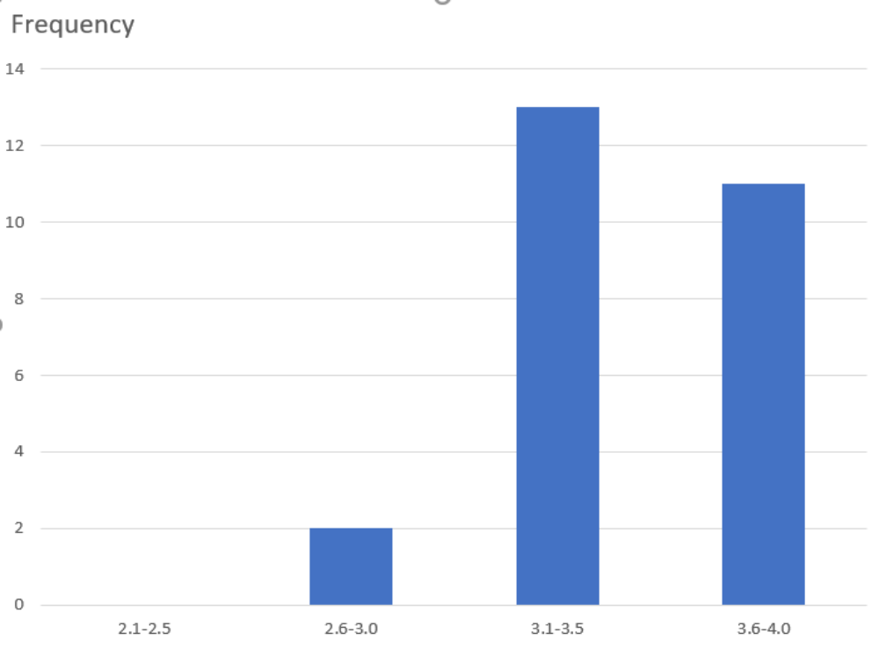
Analysis on category: Who spend between 1 & 4 hours

Slide 22
Chebyshev’s Theorem
Mean = {(0*2.3) + (2*2.8)+(13*3.3)+(11*3.8)}/26
= 3.47
Modal Class = 3.1 - 3.5
Mode = 3.3
Midrange = 3.05
Variance = {(26*316.09) - (90.3^2)}/ (26*25)
= 0.0988
Standard Deviation = root over 0.0988 = 0.314;

Slide 23
Chebyshev’s Theorem
Chebyshev’s Theorem
Mean = 3.47
Standard Deviation = 0.314
For 75% of data values fall between 2.842 and 4.098 as shown below:
3.47+(2*0.314) = 4.098
3.47-(2*0.314) = 2.842
For 88.89% of data values fall between 2.528 and 4.412 as shown below:
3.47+(3*0.314) = 4.412
3.47-(3*0.314) = 2.528
For 93.75% of data values fall between 2.214 and 4.726 as shown below:
3.47+(4*0.314) = 4.726
3.47-(4*0.314) = 2.214
Hence the mean falls within 4 standard deviation

Slide 24
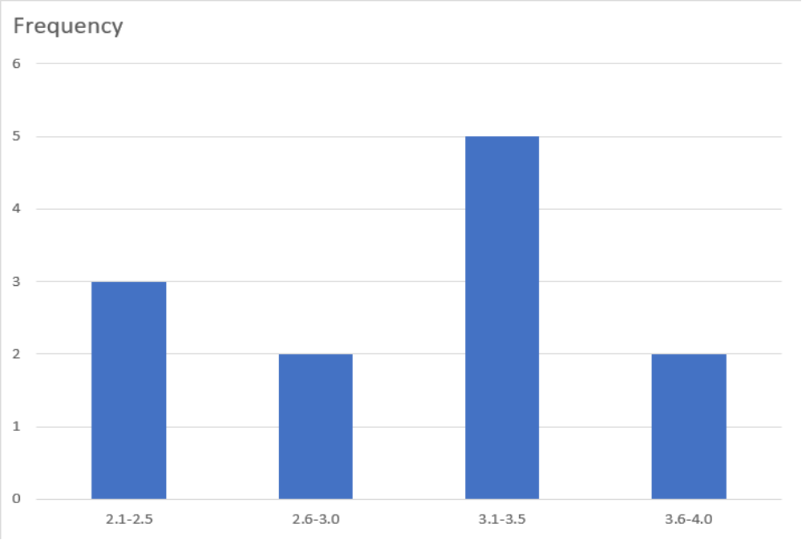
Analysis on category: Who spend more than four hours

Slide 25
Chebyshev’s Theorem
Mean = {(3*2.3)+(2*2.8)+(5*3.3)+(2*3.8)}/12
= 3.05
Modal Class = 3.1 - 3.5
Mode = 3.3
Midrange = 3.05
Variance = {(12*114.88) - (36.6^2)}/ (12*11)
= 0.295
Standard Deviation = root over 0.295 = 0.543;

Slide 26
Chebyshev’s Theorem
Mean = 3.05
Standard Deviation = 0.543
For 75% of data values fall between 1.964 and 4.136 as shown below:
3.05+(2*0.543) = 4.136
3.05-(2*0.543) = 1.964
For 88.89% of data values fall between 1.421 and 4.679 as shown below:
3.05+(3*0.543) = 4.679
3.05-(3*0.543) = 1.421
For 93.75% of data values fall between 0.878 and 5.222 as shown below:
3.05+(4*0.543) = 5.222
3.05-(4*0.543) = 0.878
Hence the mean falls within 4 standard deviation

Slide 27
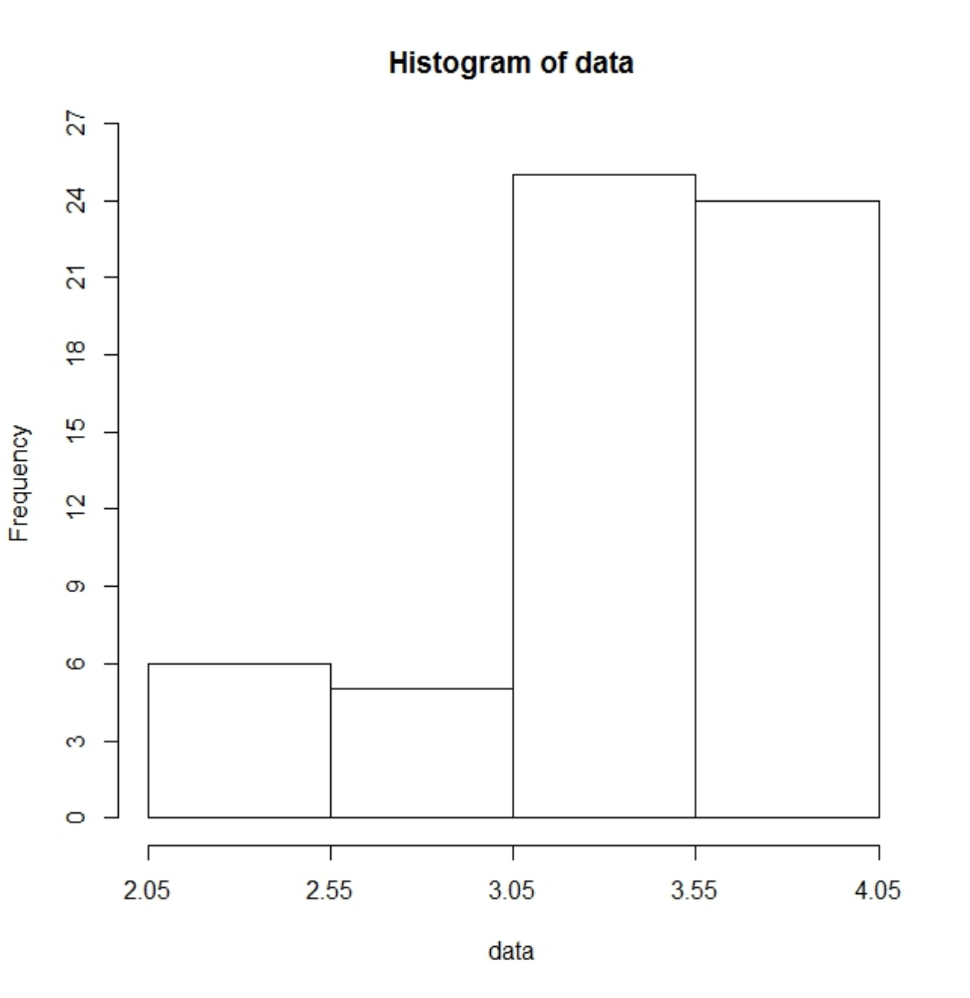
Histogram (total data)

Slide 28
Coding:
For Histogram
data <- as.numeric(scan("CGPA.txt", what = "char"))
hist(data, breaks = c(2.05, 2.55, 3.05, 3.55, 4.05), xlim = c(2.05, 4.05), ylim = c(0, 26), axes =
F)
axis(side=1, at =seq(2.05,4.05, 0.5), labels=seq(2.05,4.05, 0.5))
axis(side=2, at =seq(0, 27, 3), labels=seq(0, 27, 3))

Slide 29
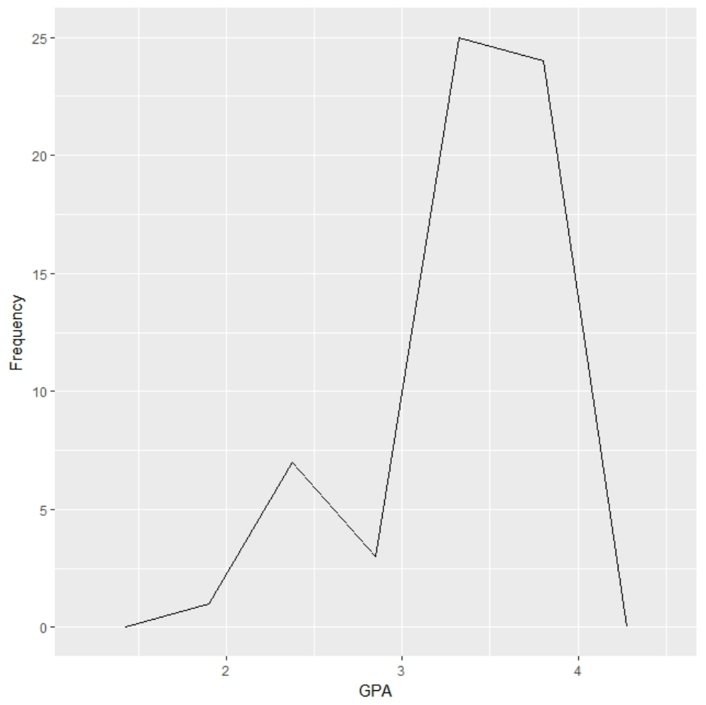
Polygon (total data)

Slide 30
Coding:For Polygon
install.packages(“ggplot2”)
library(ggplot2)
binsize <- diff(range(data))/4
ggplot(data.frame(data), aes(x=data)) +
# add a sensity line
geom_freqpoly(binwidth=binsize) +
# zoom out the plot a little bit
expand_limits(y=0) +
xlab( "GPA") +
ylab( "Frequency")

Slide 31
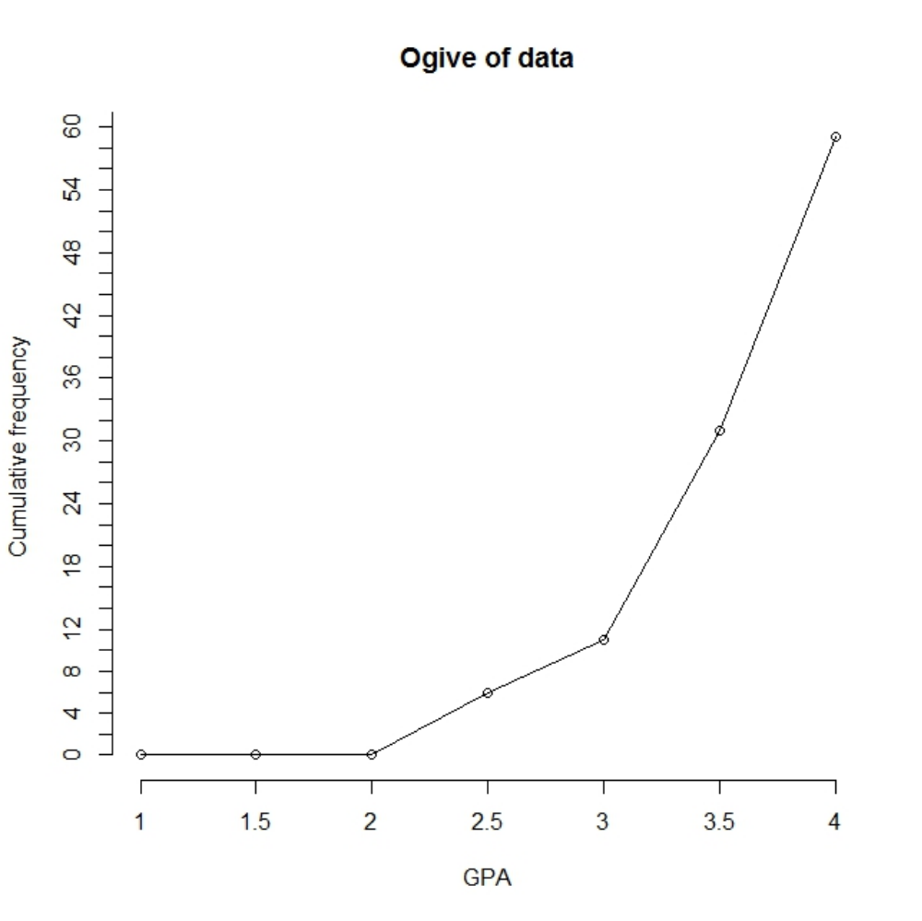
Ogives (total data)

Slide 32
Coding: For Ogives
Coding:
For Ogives
breaks <- seq(1.0, 4.0, by = 0.5)
interval.cut <- cut(data, breaks, right=FALSE, dig.lab = 4)
temp.freq <- table(interval.cut)
cumfreq <- c(0, cumsum(temp.freq))
plot(breaks, cumfreq, main="Ogive of data",
xlab="GPA", ylab="Cumulative frequency", axes =
F) # y-axis label
lines(breaks, cumfreq) # join the points
axis(side=1, at =seq(1.0,4.0, 0.5), labels=seq(1.0,4.0, 0.5))
axis(side=2, at =seq(0, 62, 2), labels=seq(0, 62, 2))

Slide 33
Full Scale Analysis
less than 1 hour
It is quite clear that majority of the students (11 students) who works less than one hour, obtains a 3.6 – 4.0 CGPA. The next majority of students (7 students) scores more than 3.1 – 3.5 CGPA. Interestingly, a few of the students 0(3 students) scored 2.1 – 2.5 CGPA and about 1 student scored 2.6 – 3.0 CGPA. The mean is 3.39.
between 1-4 hours
In this histogram, we noticed that one student scored less than 2.6 CGPA, and only 2 students scored between 2.6 – 3.0 CGPA. The clear majority of the students (13 students) scored between 3.1 – 3.5 CGPA and the remaining 11 students scored between 3.6 – 4.0 CGPA. The mean is 3.47.
more than 4 hours
We find that 3 students scored in the range of 2.1 – 2.5 CGPA while only 2 students scored in the 2.6 – 3.0 CGPA range. However, the majority of the students (5 students) scored in the 3.0 – 3.5 CGPA. And only 2 students who work more than 4 hours have more than a 3.6 CGPA.The mean is 3.05.
Therefore, we must conclude that our initial hypothesis, students with higher hours in part time job have lower CGPA, is correct and must not be rejected.

Slide 34
General Discussion
The research is meant to provide proof that the hours of work in part time job has a significant effect on students CGPA.
Contrary to what we have predicted, there does not appear to be any huge significant difference between the first group who work less than one hour and the second group who work between 1 and 4 hours.

Slide 35
Conclusion and Recommendation
Our initial hypothesis states that students that have a higher number of working hours in part time job will get a lower CGPA.vice versa, the lesser time the students spend on working , the more time they must focus on their studies and achieve better results.
However, we have come to find that spending less time in part time job does mean the students are going to achieve higher results.
Therefore, to conclude, the relationship that we focused on is correct. We would further like to recommend a future study that would conclude with a stronger hypothesis that is not influenced by any other factors. The students’ results are mostly dependent to the hours of time spent in part time job, even though other factors might also play some role. However, based on previous studies, it is suggested to minimize the number of hours in part time job.

Slide 36
References & Appendix
10. References & Appendix
1.https://www.researchgate.net/publication/276224110_Does_Part-Time_Job_Affect_College_Students%27_Satisfaction_and_Academic_Performance_GPA_The_Case_of_a_Mid-Sized_Public_University
2.https://www.google.com/search?client=firefox-b-ab&q=do+part+time+jobs+affect+students+grades&sa=X&ved=0ahUKEwiVwsrvhPnaAhXCPY8KHYK7CmkQ1QIIsAEoAg&biw=1536&bih=702
3.http://education.seattlepi.com/afterschool-work-affect-school-performance-1747.html
4. https://prezi.com/6yb5trsq8kev/does-a-job-affect-the-students-grades/
5.https://www.timeshighereducation.com/news/part-time-working-can-harm-studies/105562.article

Slide 37
Thank you

